Slide 1


SOCIAL BUZZ SQUAD

Slide 2


Today’s Agenda
Overview about the “ SOCIAL BUZZSQUAD “
Problem
The Analytics team
Process
Insights
Summary

Slide 3

OVERVIEW
Social Buzz squad often centers around influential individuals or accounts with large followings. Identifying and partnering with relevant influencers can amplify brand messages, increase reach and engagement, and foster authentic connections with target audiences.
Analysis to find top main popular categories of content
Size of the dataset (number of records)
Types of data included (text, numerical, categorical)
SOCIAL BUZZSQUAD

Slide 4

Problem
Data Preprocessing
Cleaning steps taken (removing duplicates, handling missing values)
Transformation of data into suitable format for analysis
Sentiment Analysis
Overview of sentiment analysis methodology used
Distribution of sentiment across the dataset
Insights into positive, negative, and neutral sentiment trends

Slide 5

Geographical Analysis
Distribution of social buzz across geographical regions
Regional variations in topics or trends
Insights into cultural or regional preferences
User Engagement
Metrics related to user engagement
Analysis of engagement trends over time
Identification of factors influencing user engagement
Visualizations of trends
line plots
heatmaps
Pie chart
etc.

Slide 6

The Analytics team
Myself (Himanshi)

Slide 7
DATA UNDERSTANDING
Process
1
2
DATA CLEANING
3
DATA MODELLING
4
DATA ANALYSIS
5
UNCOVER INSIGHTS

Slide 8


Slide 9
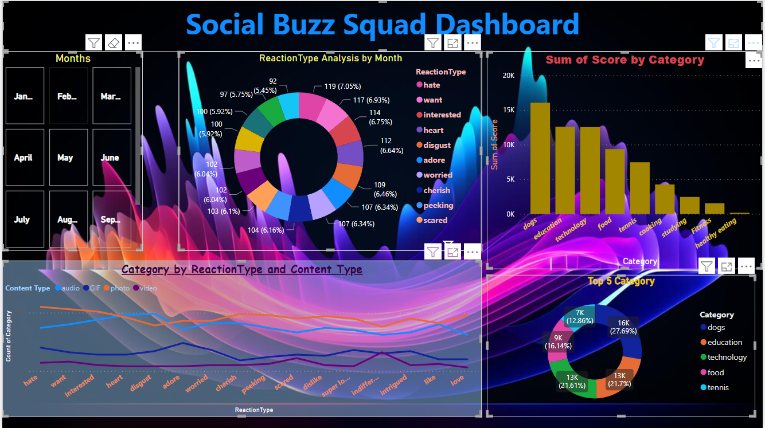

Slide 10

Summary
Social Buzz Squad has grown faster than expected in the past five years, reaching over 500 million active users every month. This rapid growth and the nature of content creation has led to a large amount of data being generated, with over 100,000 pieces of content uploaded daily. To keep up with this data, Social Buzz has had to scale up quickly.

Slide 11
Thank you!
ANY QUESTIONS?

